Slide 1

MACHINE
INTELLIGENCE
Weighted K-Nearest Neighbour
K.S.Srinivas
Department of Computer Science and Engineering

Slide 2

MACHINE INTELLIGENCE
Weighted K-Nearest Neighbour
K.S.Srinivas
Department of Computer Science and Engineering

Slide 3
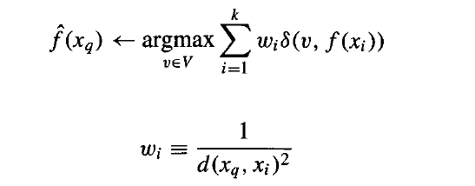
MACHINE INTELLIGENCE
Weighted KNN
Distance-weighted nearest neighbor algorithm
Weight the contribution of each of the k neighbors according to their distance to the query x_{q}
Give greater weight to closer neighbors

Slide 4
MACHINE INTELLIGENCE
Why Weighted KNN
consider the given 2-D plot of a two class data set
consider the query point x
with normal KNN with K=3 x will be classified as green
with weighted KNN and K=3 x will be classified as red since its more close to the query x
X

Slide 5
MACHINE INTELLIGENCE
Inductive Bias of KNN
The classification of an instance x, will be most similar to the classification of the K other instances that are nearby.
In simple English Birds of the same feather flock together

Slide 6
MACHINE INTELLIGENCE
Issues with KNN
K-NN slow algorithm:K-NN might be very easy to implement but as data set grows efficiency or speed of algorithm declines very fast.
Curse of Dimensionality: KNN works well with small number of input variables but as the numbers of variables grow K-NN algorithm struggles to predict the output of new data point.

Slide 7
MACHINE INTELLIGENCE
Curse of Dimensionality
The Radius or circle of influence of each data point becomes smaller and smaller as we have more attributes.
Rule of thumb – 5 data instances per attribute for learning
100 dims
2 dims
3 dims
frequency in %
distances

Slide 8
MACHINE INTELLIGENCE
Overcoming Curse of Dimensionality
The curse of Dimensionality can be overcome by:
Assigning weights to the attributes when calculating distances.
Using the “Leave-one-out” approach. Iteratively, we leave out one of the attributes and test the algorithm by the cross-validation method. The exercise can then lead us to the best set of attributes.
Rule of thumb – 5 data instances per attribute for learning

Slide 9
MACHINE INTELLIGENCE
Issues with KNN
K-NN needs homogeneous features: If you decide to build k-NN using a common distance, like Euclidean or Manhattan distances, it is completely necessary that features have the same scale, since absolute differences in features weight the same, i.e., a given distance in feature 1 must means the same for feature 2

Slide 10
MACHINE INTELLIGENCE
Issues with KNN
Optimal number of neighbors: One of the biggest issues with K-NN is to choose the optimal number of neighbors to be considered while classifying the new data entry
Imbalanced data causes problems: k-NN doesn’t perform well on imbalanced data. If we consider two classes, A and B, and the majority of the training data is labeled as A, then the model will ultimately give a lot of preference to A. This might result in getting the less common class B wrongly classified.

Slide 11
MACHINE INTELLIGENCE
Issues with KNN
Outlier sensitivity: K-NN algorithm is very sensitive to outliers as it simply chose the neighbors based on distance criteria.
Missing Value treatment: K-NN inherently has no capability of dealing with missing value problem.

Slide 12
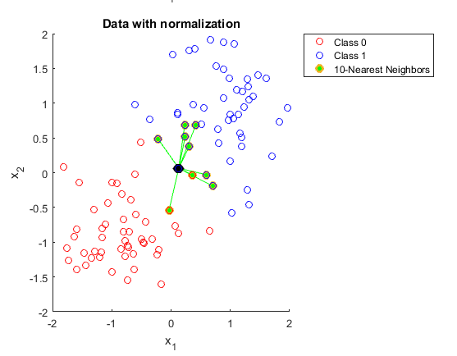
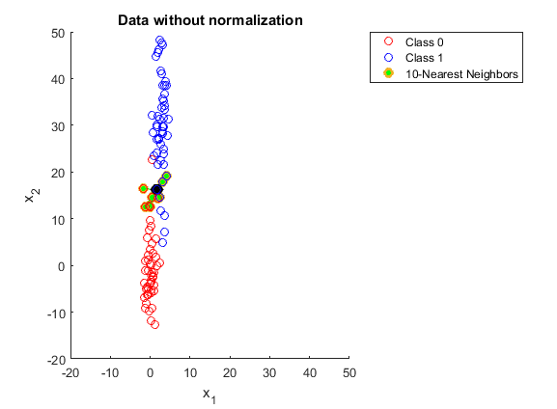
MACHINE INTELLIGENCE
Issues with KNN

Slide 13
MACHINE INTELLIGENCE
KNN Computational Complexity
Basic kNN algorithm stores all examples
Suppose we have n examples each of dimension d
O(d) to compute distance to one example
O(nd) to find one nearest neighbor
O(knd) to find k closest examples examples
Thus complexity is O(knd)
This is prohibitively expensive for large number of samples
But we need large number of samples for kNN to work well!

Slide 14
THANK YOU
K.S.Srinivas
srinivasks@pes.edu
+91 80 2672 1983 Extn 701

